Slide 1
Body Pose Recognition with Hierarchical Topological Skeleton Model

Slide 2
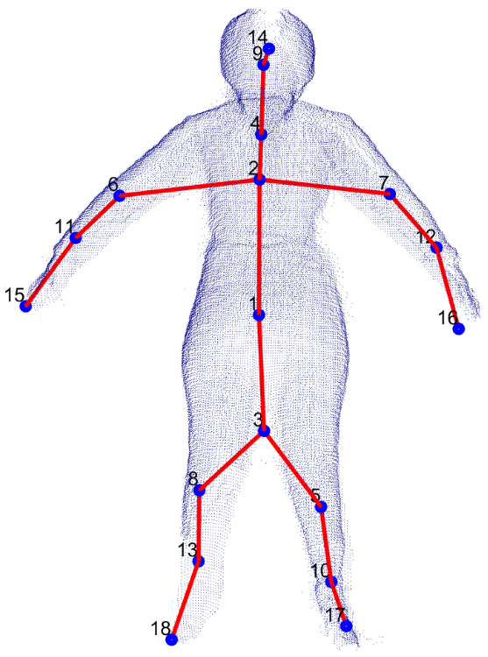
Pose Recognition with Labelled Key Body Extremities
Hierarchical Skeleton tree with labelled extremities used for Pose Recognition
At each of 5 key extremity parts, three neighboring topological nodes of skeleton tree form 1x9 3D vector feature set.
5x9=45 features per pose
SVM classifier model is used for pose classification
Notes:
Once these extremity nodes are labelled, they along with their 2 neighbouring topological nodes are bundled into a feature set which can further be used for pose classification.

Slide 3
Evaluation in Real Dataset
2 subjects perform 7 simple poses
Conditions :
Adequate space in common FoV
The subject exits from the FoV of one (or more) device, with the partial/full loss of completeness in the 3D shape.
No obstacles in the observation area
Poses: AD, AU, AF, UD, AT, LU, BD
Dataset of Subject | A | B
Type of Data | Training | Testing
Number of poses | 7 | 7
Average number of frames per pose | 50 | 10
Total No. of frames | 350 | 90
Approx. duration | 4 mins | 2 mins
AD | AU | AF | UD | AT | LU | BD
Arms down | Arms Up | Arms Front | Arm Up & Arm down | Arms at T-pose | 1Leg UP | Bend Down
Notes:
Here, we use another dataset which are actually captured from the Kinect sensors of the previously mentioned experimental setup. In the experiments, 2 subjects perfomed 7 simple poses. The datset from 1 subject is used for training the proposed model whereas the the othe dataset from 2nd subject is used for testing.

Slide 4
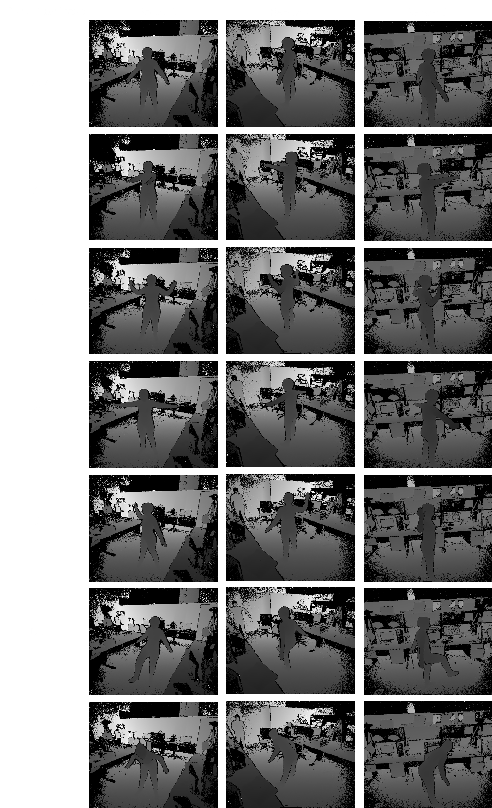

Slide 5
Key Parts Classification
Pose Configurations Classification
Notes:
The figure on the left shows the performance of proposed classifier for key body extrmeites. And then these outputs are used in classifying the poses with classification results as shown on the right side.
As you can see the overall pose classification is around 90%. It is due to the simplicity in real dataset.

Slide 6
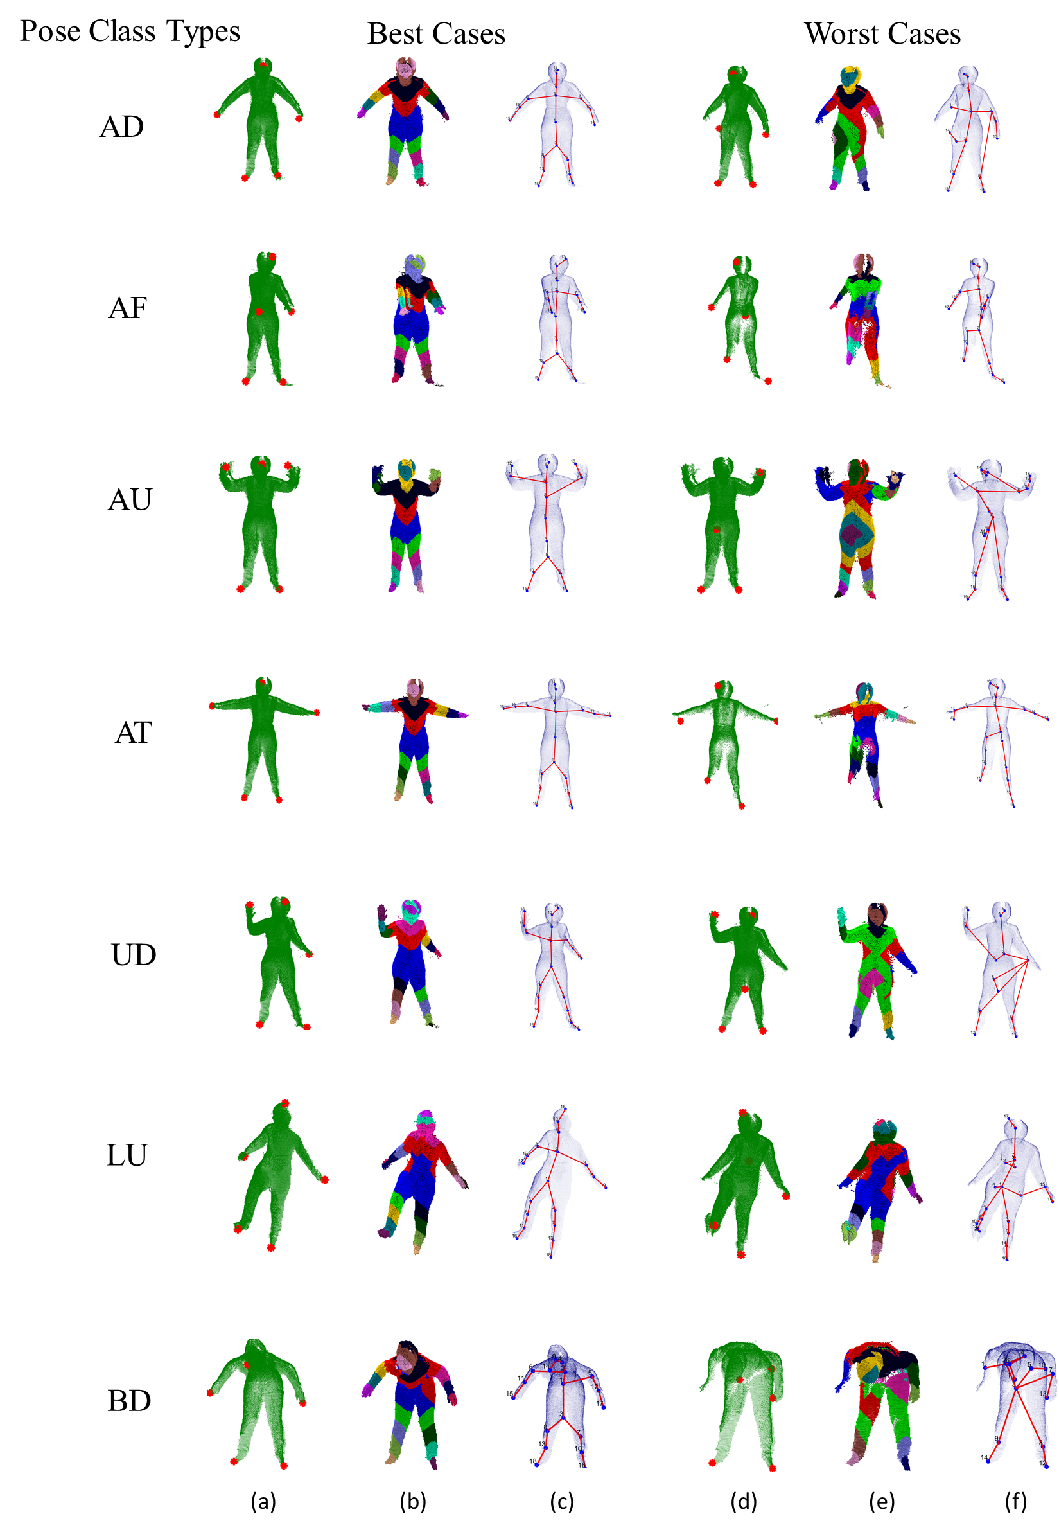
Notes:
Here are the qualitative results. With best cases and worst cases.
In worst cases, if the feature extremities are not correctly detected, it affects the rest of the process including clusterization and skeleton formation.

Slide 7
Conclusion & Future Works

Slide 8
Calibration of Multiple Depth Sensors
A novel calibration tool for multiple depth sensors. was proposed
Calibrates more than two generic 3D sensors
Spheres are viewpoint invariant
RR strip: automatic localization of spherical centre
Provides a world coordinate frame of reference
The study of RR striped spheres shows that
Larger spheres give better performance with sensors placed apart
Spherical localization from depth sphere give better performance
Performs well against 3 available techniques in terms of shape reconstruction and spatial consistency with errors lower than 0.02 m at 90% probability.
The computed extrinsic parameters used to fuse the information from sensors
Notes:
Finally, the proposed framework can be summarized as follow as

Slide 9
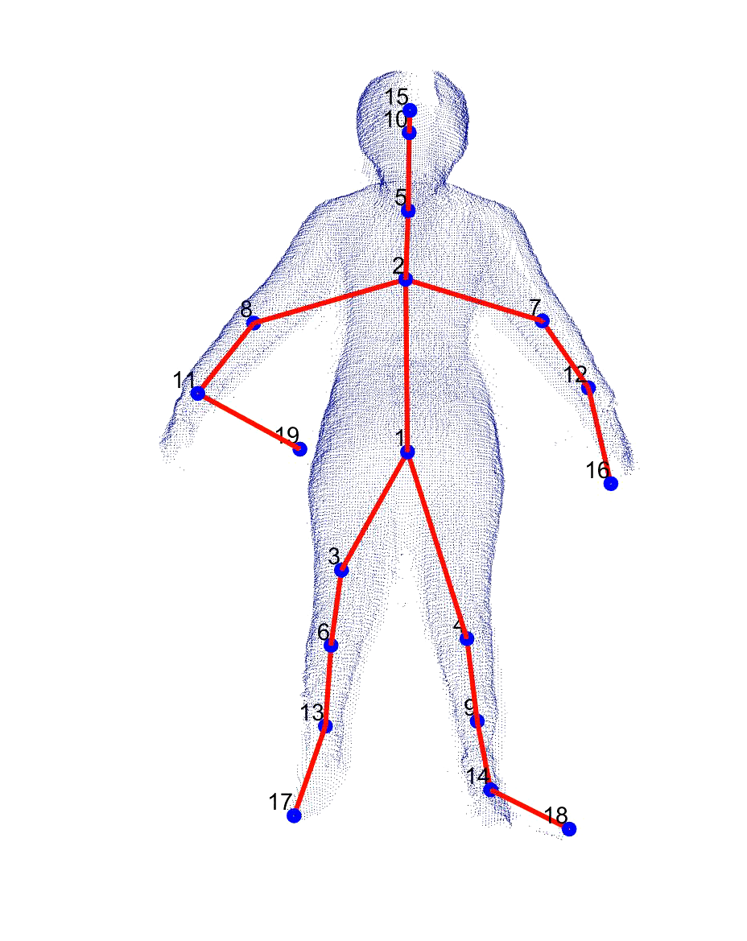
Identification of Body Extremities for Pose Recognition through Topological Analysis
The second stage of proposed framework
Performs topology-based body segmentation and classification into H, RH, LH, RF, LF
Does not require shape template or co-operation of the subject
Overcomes the challenges caused by self-occlusion
Proposes a search algorithm to fuse multiple point cloud meshes
Overall key body part detection rate at 90% below error of 0.15m.
The geodesic mapping function → major topological clusters of body parts.
Generated topological skeleton tree used for pose recognition
Key Body part classification accuracy
Synthetic dataset (easy and hard): 86%
Real dataset (7 simple poses): 95.75%
Robust against variations in poses and shapes
Pose classification accuracy: 90%

Slide 10
Future Works
Fully automated calibration system
Improvement in localization of feature extremity points
Recognition of poses in keyframes
Pose recognition of multiple subjects or subject engaging in a task
Hardware accelerations
Notes:
This future scope of the proposed framework is as follows:
In the work, the spheres in calibration tool were manually identified as X, Y, Z and original points asf the coordinate frame. The calibration process can be fully automated by constructed calibration tool with four distinct spheres of different radii.
By refining localization of these points would lead to better classification of key body extremities thereby improving the performance in pose recognition. This can be done by updating the feature extremity points through enhancements over time and filtering unwanted candidates with help of particle [64] or Kalman filters
.Rather than recognizing poses in each frame in an action sequence, the system can be programmed to generate the hierarchical skeleton at specific intervals skeleton tree model is generated at keyframe in action sequence. This Reduces the computation time and memory
The whole framework was implemented on CPU hardware. With Kinect sensors connected to the same CPU, the entire process was slowed. Hence, the final part of the second stage of the framework was executed offline. It could be realized in real-time and made more efficient with the help of the latest graphics processing units More real-time efficiency with GPU
The framework proposed in this thesis could serve as a preliminary study for the actions/poses analysis of more than one person in any environment.
Proposed feature sets can identify and track multiple bodies at the same time.
These features can determine the presence of an object in hands while subject interacts with daily items.
Such technique can give a complete understanding of the subject’s actions in any given living space.

